Slide 1
Sports Complex Management System (SCMS)
A digital platform to replace manual ID-card-based equipment issuing in college sports complexes
Presented By :- Harshjot Singh • Jaspreet Singh • Sanveer Singh
B.E — Artificial Intelligence & Machine Learning
Software Engineering project - 2026

Slide 2
Problem Statement
Challenges in the Existing System
Manual & inefficient process – Students currently deposit physical ID cards to borrow sports equipment — slow, unrecorded, hard to track
No centralized record of inventory (what's issued, available, or damaged)
No fair mechanism to prevent a few students from monopolizing high-demand equipment/slots
Need: an online system for issuing, tracking, and fairly scheduling equipment usage

Slide 3
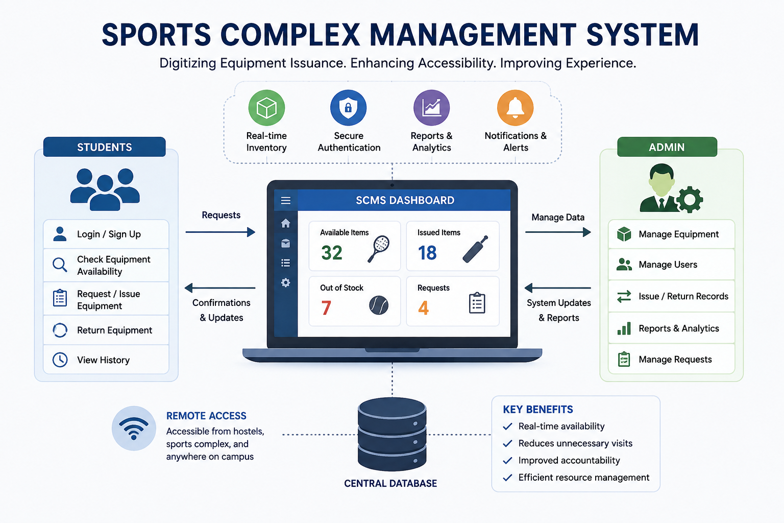
Proposed Solution
Our Proposed System
Digital ID-based issue/return via QR code scan (no physical card handover)
Real-time inventory dashboard for sports complex staff
Fairness-weighted scheduling algorithm — prioritizes students who've played less recently, capped daily usage
Extras: usage analytics, return reminders, damage logging

Slide 4
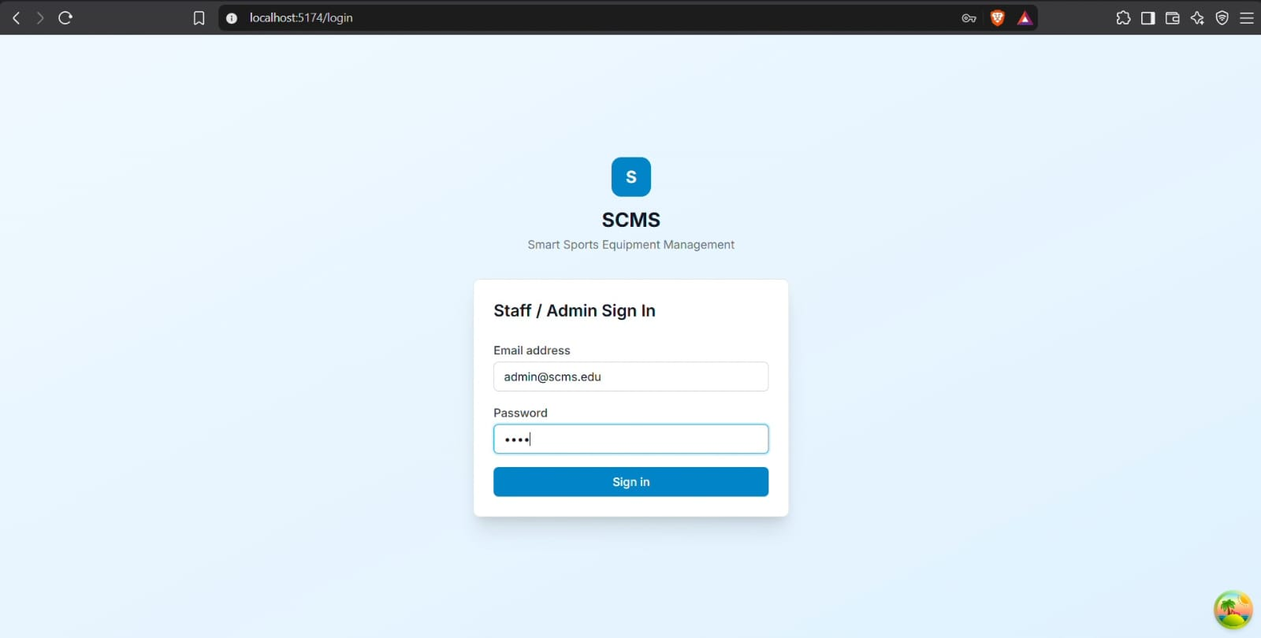
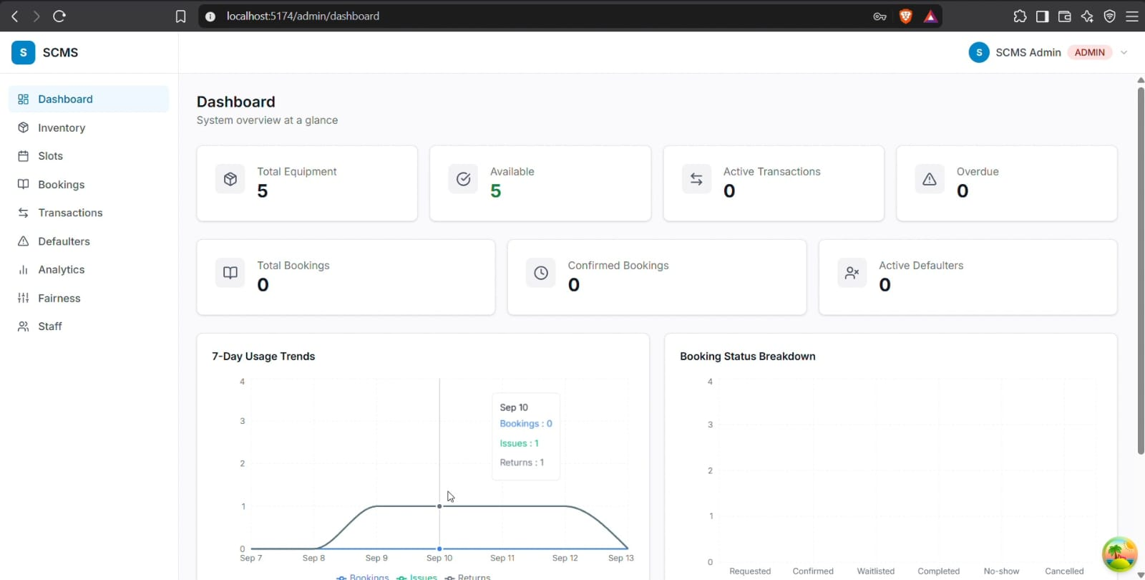
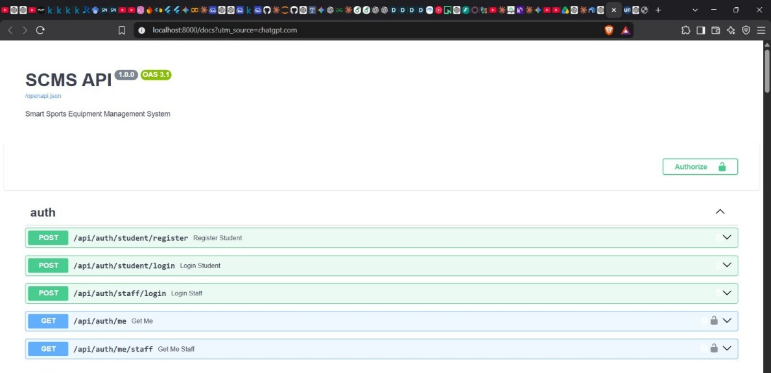
Overview of scms
Software Engineering project - 2026

Slide 5
Motivation
Why SCMS?
Real-world impact – Current process is manual, paper/register-based, and prone to errors
Application of Software Engineering – Provides practical experience in requirements analysis, system design, database modeling, implementation, and testing.
A digital platform to replace manual ID-card-based equipment issuing in college sports complexes
Better campus resource management – Improves student convenience while increasing equipment accountability, utilization, and system efficiency.

